Slide 1
Online News Popularity
- data mining project by xxx xxx xxx xxx

Slide 2
Introduction (weixin

Slide 6
Methodology
Data and sample
Description of Variables
Data pre-processing(xiang)
Exploratory analytical methods
-Classification
-Regression(w&x&z)
Data visualization Analysis
(all)

Slide 7
Data and sample

Slide 9
Descriptions of variables

Slide 11
Data Pre-processing (Xiang

Slide 13
Exploratory
Analytical Methods
Classification

Slide 22
ec

Slide 23
Exploratory
Analytical Methods
Regression
(Xiang, Weixin, Zhang

Slide 24
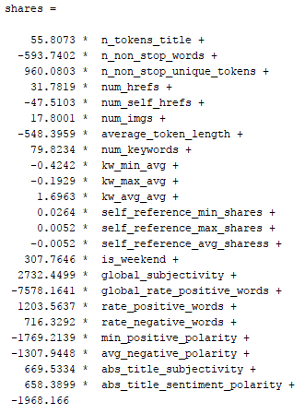
ec
Linear Regression
Videos doesn’t matter. In the function, there are no attribute called ‘num_videos’, which is put into the dataset. It tells us that the number of video does not affect the number of shares, so that it does not show up in the equation.
The words in title do matter. In the model function, the coefficient value before the attribute ‘n_token_title’ is 55.8073, which means that it adds 55 new shares per ‘n_token_title’ increase one
‘average_token_length’ do harm to the shares. This attribute represents the average length of the words in the content. According to the equation above, the coefficient before this attribute is -548, which means that there are 548 shares lost per average length of the words in the content be added.

Slide 25
ec

Slide 26
ec

Slide 27
ec

Slide 28
ec

Slide 29
ec

Slide 30
Data visualization Analysis

Slide 31
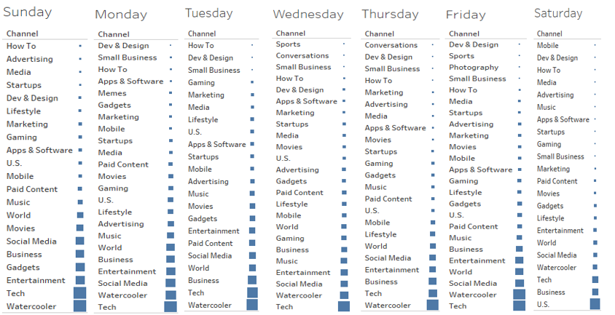
ec
This graph describes every topic’s popularity sorted by the date, we can see that Tech is the most popular topic in Monday, Wednesday, Friday, and the Watercooler is popular in Sunday, Tuesday, Thursday. the lowest 2 topics is conversations and Dev&Design topics.

Slide 32
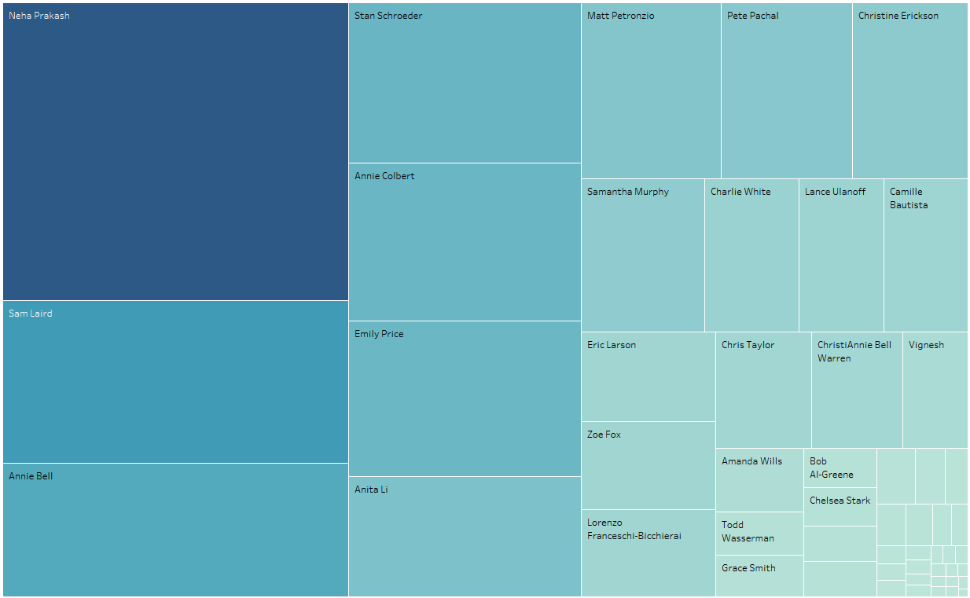
ec
Then, we find that the top 2 topics in a week expect Saturday is Tech and WaterCooler, so we want to find why they are popular in most of days. Because those are all news, so we can analyze the author according to these news to find out the reason.

Slide 33
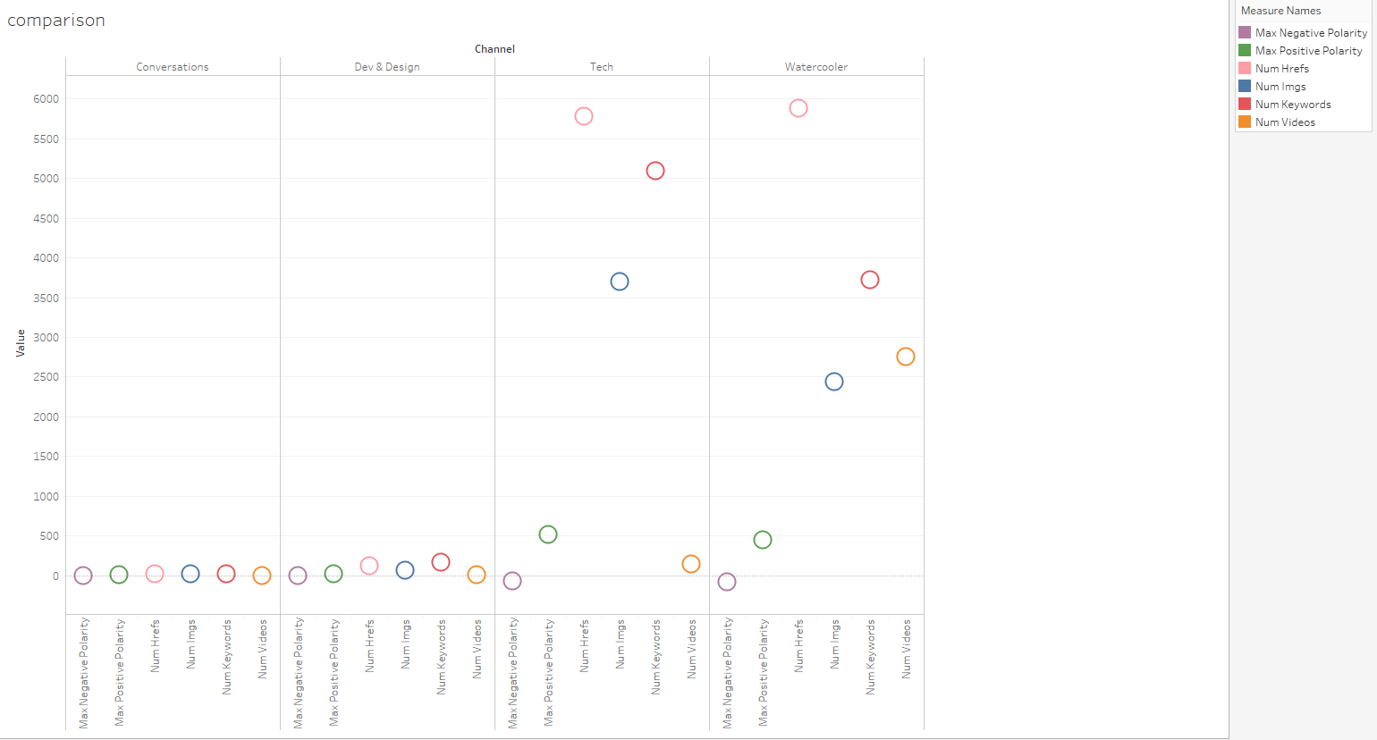
ec
we find that the top2 news topic have more number of links and keywords in the news. Because more links will give readers more choice, readers can read more related article following their own hearts. Putting more keywords rather than meaningful words will save readers time.

Slide 34
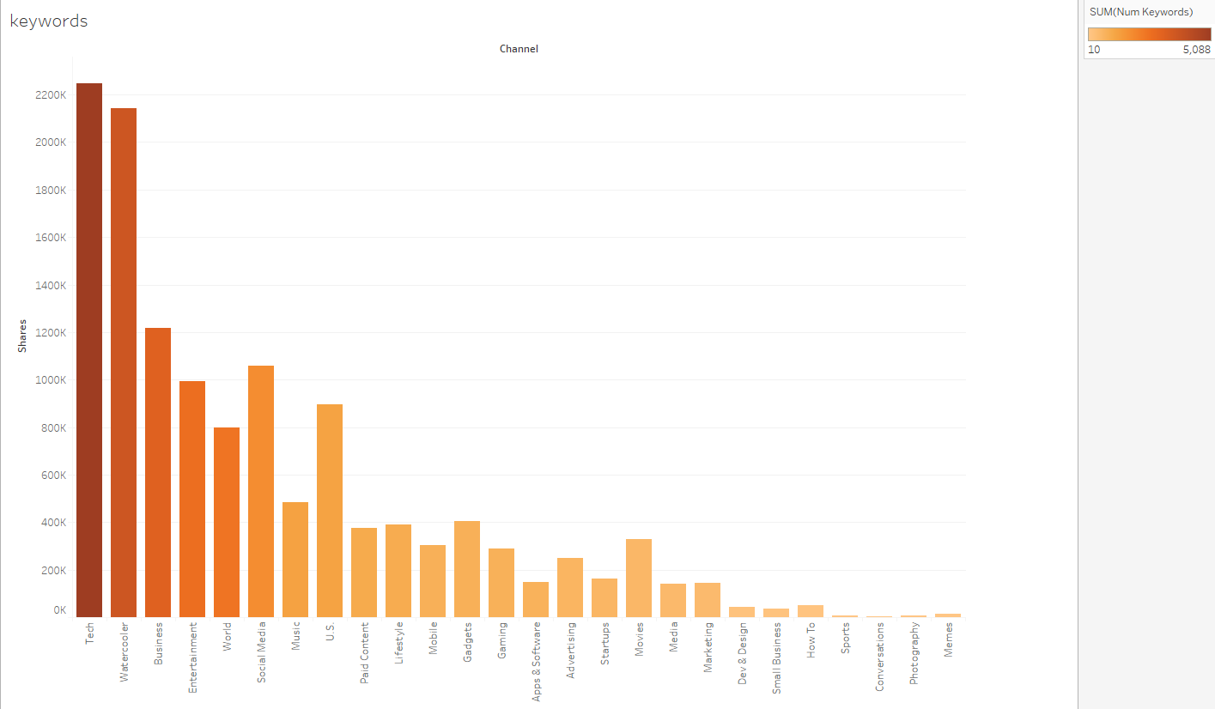
Here, we sort all the topics in the dataset by the number of keywords, To increase the number of shares, companies need add more keywords into the Tech, watercooler, and Business topics’ articles

Slide 35
Conclusion(all)

Slide 36
Ff

Slide 37
ec

Slide 38
ec

Slide 39
ec

Slide 40
ec

Slide 41
ec

